Slide 1
A Brief Intro to SEM
David Errington
Master of Data Science & Analytics Student
Faculty of Science / Faculty of Graduate Studies

Slide 2


Slide 3
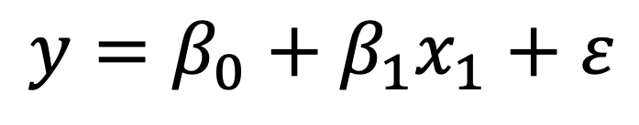
Re-Express Linear Regression as SEM
Step 1: Simple Linear Regression Equation
$$y=β_{0}+β_{1}x_{1}+ε$$

Slide 4
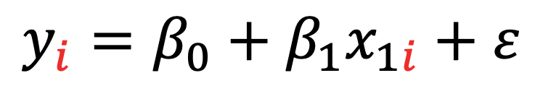

Re-Express Linear Regression as SEM
Step 2: Add subscript $i$ to each variable
$$y_{i}=β_{0}+β_{1}x_{1i}+ε$$

Slide 5

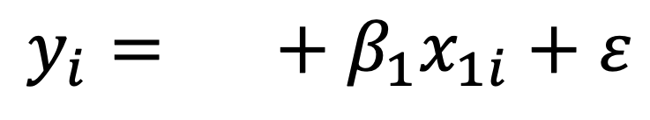
Re-Express Linear Regression as SEM
Step 3: Take the intercept…
$$β_{0}$$
$$y_{i}=β_{0}+β_{1}x_{1i}+ε$$
Intercept

Slide 6


Re-Express Linear Regression as SEM
Step 3: And replace it with $α$
$$α$$
$$y_{i}=β_{0}+β_{1}x_{1i}+ε$$
Intercept

Slide 7
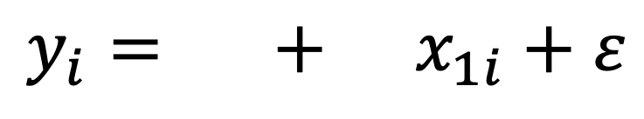

Re-Express Linear Regression as SEM
Step 4: Take the regression coefficient(s)...
$$α$$
$${ β}_{1}$$
$$y_{i}=β_{0}+β_{1}x_{1i}+ε$$
Intercept
Coefficient

Slide 8

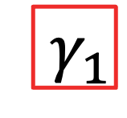
Re-Express Linear Regression as SEM
Step 4: And replace it(them) with $γ$
$$α$$
$${ γ}_{1}$$
$$y_{i}=β_{0}+β_{1}x_{1i}+ε$$
Intercept
Coefficient

Slide 9
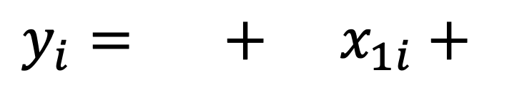

Re-Express Linear Regression as SEM
Step 5: Take the error term...
Error
$$α$$
$${ γ}_{1}$$
$$ε$$
$$y_{i}=β_{0}+β_{1}x_{1i}+ε$$
Intercept
Coefficient

Slide 10


Re-Express Linear Regression as SEM
Step 5: And replace it with $ζ_{i}$
Error
$$α$$
$${ γ}_{1}$$
$$ζ_{i}$$
$$y_{i}=β_{0}+β_{1}x_{1i}+ε$$
Intercept
Coefficient

